Slide 1
APAN5400
Project Presentation
Group 3：
Zixuan Lin, Boping Song, Peng Yan, Junyi Zhu, Kangning Lei

Slide 2

Project Overviw
Background
The growing volume of financial data, especially daily stock prices and firm-level metadata, presents new challenges for data storage, access, and usability. Investors, analysts, and developers increasingly need reliable, scalable systems that can handle time-series price data alongside diverse company profiles to support research, screening, and portfolio evaluation.
CONTENTS
Problem Statement
Many users, specially students or beginner investors, may recognize a stock ticker (like TSLA or BABA) but lack context about what the company actually does.
They need a system that not only retrieves prices, but also provides business background, industry classification, and company size in a seamless way.
Notes:
The Commodity Futures Trading Commission (CFTC) provides key market metrics—such as open interest and trader counts—for futures and options markets. These metrics help financial institutions, regulators, and analysts assess market dynamics, including:
Dominance of fund managers (who may drive large price movements)
Speculative activity (indicating potential market instability)
Trends in trader positioning (useful for volatility forecasting)

Slide 3
Data Source Specification and Procurement
Attribute | Stock Price Data | Company Information Data
Source | Nasdaq API(Free) | Yahoo Finance API(Free)
Time Range | 1962 to 2018 | Still updated
Number of Records | 1.5 million rows * 14 columns | More than 3000 companies’ information
Granularity | Per day | Per company
Key Unique | ticker & date | ticker
Volume | 1.8GB | 2MB(3000 companies we used)
Data Format | CSV | CSV, JSON
Key Fields(Details in next page) | ticker, date, open, close, volume | MongoDB

Slide 4
Quality Dimensions and Licensing
Quality Dimensions
Both our datasets are good in accuracy, validity, and Uniqueness
Our company information databases in MongoDB have many NA values because yfinance does not have the information for some companies, but this does not influence our code running, and can be easily edited in the future.
Licensing
Both our datasets are free to use with no limitation from those APIs.

Slide 5

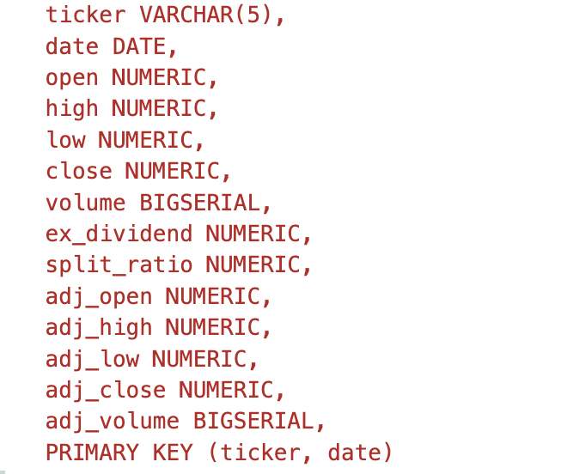
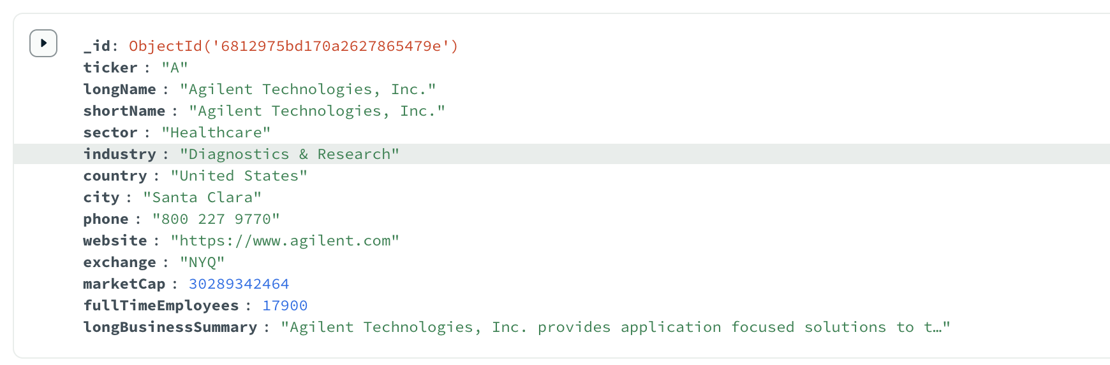



Design Choices & Technologies Rationale
pgAdmin4
Use SQL to store stock data.
Well-structured, and much of the data is numeric.
Ticker and date are used as the primary key.
Save storage space and increase searching speed.
MongoDB
Use NoSQL to store company information.
Easy to store and edit unstructured data, which includes websites, numbers, and long strings.
Including the same ticker to connect with stock data.
Spark(extra data generation)
More values to generate based on requests.
Reduce the storage size
Flask
Create a website that combines those datasets and functions.

Slide 6
Design Performance
Storage :
• In pgAdmin4, our stock data size is about 2.4GB, which is not a significant increase from the raw data of 1.8 GB.
Fast Read Speed:
• 2000ms to read the whole data set(15M rows).
• 2ms to 4ms to read selected (4000 rows) data by searching on primary key: ticker and date.
Spark:
Flexible calculation
Reduce 25% of the data size to store, and this number can be increased if more calculations added in.

Slide 7
Scalability
Storage
Many other stock data from different API and databases can be stored in this pgAdmine4 database, since stock data is numeric and uses a similar structure(mainly based on ticker and data).
More companies’ information and details can be easily inserted into the MongoDB database.
Now 2.5GB data size can be expanded to 1~2TB based on use case in the future.
Compute
Using Spark allows for distributed computation and improvement in hardware to increase the performance.
More functions and elements with Spark can be inserted into the website
Infrastructure
Using cloud storage or local storage allows for manual scaling. Cloud storage offers greater flexibility.

Slide 8
Future Cost
Assume 1TB Data | Local (Cheap but hard to manage; Have risk of aging) | Cloud (Expensive but Flexible)
Storage | HDD: $30~$50 | AWS EBS: $80 per month
Compute (8Core CPU, 32GB RAM) | $630 fixed cost and 30$ per month cost | AWS EC2: $138 per month
Networking/Egress Costs | AWS: $0.09/GB
Choices:
Best Performance: Cloud Storage and Computing. We can modify it when our data grows without loss, and it is easy to manage.
Most Economical: Hybrid Local Storage and Cloud Computing. We can store out data locally with low price, and use Cloud computing to avoid hardware aging.

Slide 9

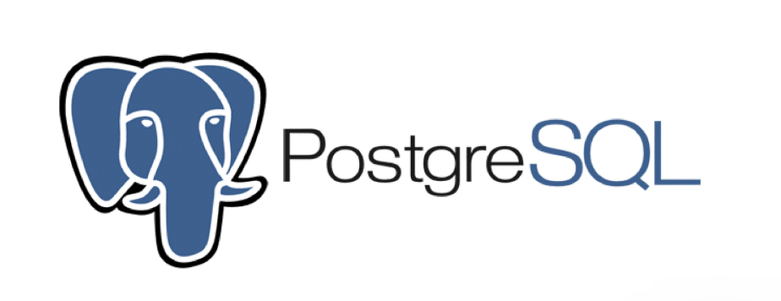

Conclusion & Future Improvements
What We Did？
API
Provide API code to access Nasdaq database
PostgreSQL
Store large scale stock price data (15M+ Rows)
Mongodb
Store flexible company information ( semi - structured data from Yahoo)
Flask
Allows users to run real-time queries by ticker and date, customize returned fields, and calculate derived metrics like daily return or price volatility
Next Steps
Hybrid Deployment Model
Store data locally for low-cost retention, but perform computations on cloud-based VMs (e.g., Spark on AWS). This improves cost-efficiency while maintaining speed and scalability
Data Enrichment
Integrate more fundamental data such as P/E ratio, earnings reports, or ESG scores to provide deeper company insights.
Flask Advanced Query Capabilities
Support multi-ticker comparisons, keyword-based screening, and multi-criteria filtering
Personalization
Allow saved queries, user-specific dashboards

